Slide 1

Public Key Encryption

Slide 2
Intuitive Model I
Algorithms
Key generation
Outputs public key k, private key k’
Encryption E
Input: message m, public key k
Output: ciphertext E_{k}(m)

Slide 3
Intuitive Model II
Decryption D
Input: ciphertext c, private key k’
Output: plaintext D_{k’}(c)
Correctness (standard)
For any valid pair (k, k’) and message m
D_{k’}(E_{k}(m))=m

Slide 4
Intuitive Model III
Many legitimate senders
Alice, k
One receiver
E_{k}(M_{A})
Bob, k’
E_{k}(M_{C})
Carol, k
E_{k}(M_{D})
Dorothy, k
Eve, k
Eavesdropping adversary

Slide 5
Semantic Security (Sym.)
Recall semantic security for symmetric encryption
“Game” between challenger and adversary
Challenger chooses key k
Adversary chooses two plaintexts m₀, m₁
Challenger chooses random b∈{0,1} and sends E_{k}(m_{b}) to adversary
Adversary returns b’ and wins if b=b’ with probability significantly more than 0.5

Slide 6
Semantic Security (Pub.)
“Game” between challenger and adversary
Challenger chooses public key k, private key k’
Challenger sends k to adversary
Adversary chooses two plaintexts m₀, m₁
Challenger chooses random b∈{0,1} and sends E_{k}(m_{b}) to adversary
Adversary returns b’ and wins if b=b’ with probability significantly more than 0.5

Slide 7
Comments on Sec. Def.
Adversary has public key
➔ Chosen-plaintext attack is “for free”
Semantic security definition enforces “probabilistic encryption”
Any plaintext is encrypted to many ciphertexts

Slide 8
Trapdoor One-Way Func. I
Trapdoor one-way function f:D→R
Has trapdoor information k’∈{0,1}*
Properties
f(x) is easy to compute for all x∈D
For random x∈D, no efficient algorithm can invert f(x)
➔f is OWF
There exists an efficient algorithm A s.t. A(f(x),k’)∈f⁻¹(f(x)) for all x∈D

Slide 9
Trapdoor One-Way Func. II
Trapdoor one-way bijective (1-1 & onto) function
Implies public-key encryption
Encryption – f(m)
Decryption – A(f(m),k’)
Example
If discrete log is hard in (G,⊕) with base g
x→g^{x} is OWF but not trapdoor-OWF
DDH can be used to create trapdoor-OWF

Slide 10
ElGamal Encryption I
Published by ElGamal in 1985
Alice publishes (G,⊕), g as public parameters
Key generation
Private key - random x∈{0,…,O(g)-1}
Public key - g^{x}
Encryption of m∈G
Choose random y∈{0,…,O(g)-1}
Ciphertext - (g^{y}, m⊕g^{xy})

Slide 11
ElGamal Encryption II
Decryption of ciphertext (u,v)=(g^{y}, m⊕g^{xy})
Compute u^{x}=g^{xy}
Compute (g^{xy})⁻¹
Compute m=v⊕ (g^{xy})⁻¹
Security – based on DDH
Performance
Computation – two exponentiations in group
Ciphertext size – at least twice message size

Slide 12
PKE & Composite Integers

Slide 13
Overview
Composite integer n=pq
Easy to compute from factors
Easy to compute ϕ(n) from factors
Hard to compute factors from n
Exercise: show that it is hard to compute ϕ(n) from n
Computing ϕ(n) implies factoring
Can hardness be used for encryption?

Slide 14
Chinese Remainder Theorem I
Tool for analysis of ℤ_{mn}
ℤ_{mn} is a ring
ℤ_{mn} = {0,…,mn-1}
+_{mn}, ⋅_{mn} – addition & multiplication modulo mn
ℤ_{m}×ℤ_{n} is a ring of pairs
ℤ_{m}×ℤ_{n}={(a,b) | a∈ℤ_{m}, b∈ℤ_{n}}
(a,b) + (c,d)=(a+_{m}c,b+_{n}d)
(a,b) ⋅ (c,d)=(a⋅_{m}c,b⋅_{n}d)

Slide 15
CRT II
Definition: Let (R,+_{R},⋅_{R}), (S,+_{S},⋅_{S}) be two rings, and let f:R→S. We say that f is an isomorphism if:
f is bijective
∀ a,b∈R, f(a+_{R}b)=f(a)+_{S}f(b)
∀ a,b∈R, f(a⋅_{R}b)=f(a)⋅_{S}f(b)
CRT: Let m, n∈ℕ, gcd(m,n)=1. Then, there exists an isomorphism f:ℤ_{mn}→ℤ_{m}×ℤ_{n}, given by
f(a)=f(a mod m, a mod n)

Slide 16
CRT III
The inverse mapping f⁻¹: ℤ_{m}×ℤ_{n} →ℤ_{mn} given by
f⁻¹(a,b)=[an(n⁻¹ mod m)+bm(m⁻¹ mod n)] mod mn
Example
m=3, n=5
f(8)=(2,3), f(11)=(2,1)
f⁻¹(2,3)=(2*5*2+3*3*2) mod 15=8
f(8+₁₅ 11)=f(4)=(1,4)

Slide 17
CRT IV
Example (cont.) (m=3, n=5)
f(8+₁₅ 11)=f(4)=(1,4)
f(8)+f(11)=(2,3)+(2,1)=(2+₃ 2, 3+₅ 1)=(1,4)
f(8⋅₁₅ 11)=f(13)=(1,3)
f(8)⋅f(11)=(2,3)⋅(2,1)=(2⋅₃ 2, 3⋅₅ 1)=(1,3)

Slide 18
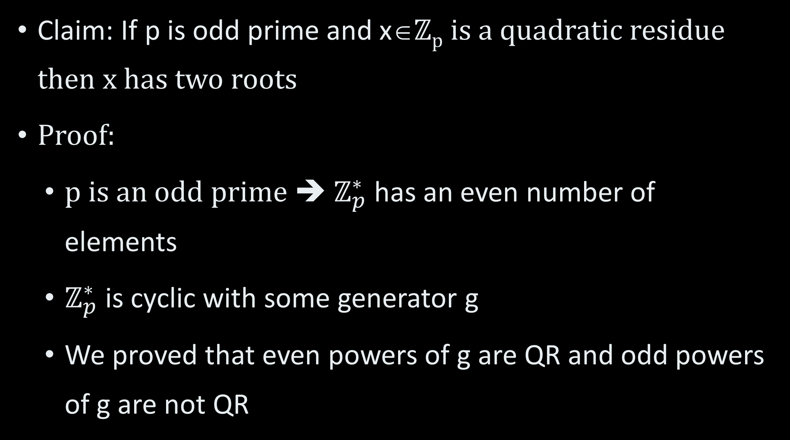
Square Roots I
Claim: If p is odd prime and x∈ℤ_{p} is a quadratic residue then x has two roots
Proof:
p is an odd prime ➔ $ℤ_{p}^{∗}$ has an even number of elements
$ℤ_{p}^{∗}$ is cyclic with some generator g
We proved that even powers of g are QR and odd powers of g are not QR

Slide 19
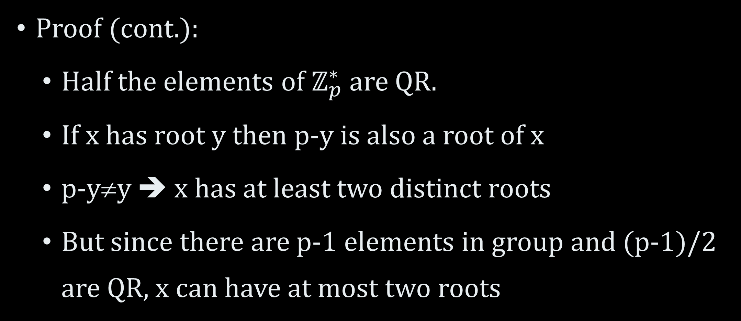
Square Roots II
Proof (cont.):
Half the elements of $ℤ_{p}^{∗}$ are QR.
If x has root y then p-y is also a root of x
p-y≠y ➔ x has at least two distinct roots
But since there are p-1 elements in group and (p-1)/2 are QR, x can have at most two roots

Slide 20
Square Roots III
Claim: If p, q are odd primes, n=pq and x∈ℤ_{n} is a QR then x has four roots
Proof:
There exists y∈ℤ_{n} s.t. y²≡x mod n
Use CRT to map x→(x₁,x₂)∈ℤ_{p}×ℤ_{q} and y→(y₁,y₂)∈ℤ_{p}×ℤ_{q}
By CRT (y₁)² ≡x₁ mod p ➔(p-y₁)² ≡x₁ mod p
By CRT (y₂)² ≡x₂ mod q ➔(q-y₂)² ≡x₂ mod p

Slide 21
Square Roots IV
Proof (cont.):
There are four pairs (y₁/p-y₁,y₂/q-y₂) which are square roots of (x₁,x₂)
➔If f⁻¹ is the inverse CRT mapping then
f⁻¹(y₁,y₂), f⁻¹(p-y₁,y₂), f⁻¹(y₁,q-y₂), f⁻¹(p-y₁,q-y₂)
Are all roots of x=f⁻¹(x₁,x₂)
Exercise – show that these are all the roots of x

Slide 22
RSA I
Key generation:
Choose distinct large primes p, q
Let n=pq
Choose e such that (e,ϕ(n))=1 (ϕ(n)=(p-1)(q-1))
Compute d such that de≡1 mod ϕ(n)
Using Extended-Euclid (e,ϕ(n))
The public key is (n,e)
The private key is d

Slide 23
RSA II
Encryption
Plaintext m∈ℤ_{n}
Ciphertext c≡m^{e} mod n
Decryption
m ≡ c^{d} mod n
Correctness
c^{d} ≡(m^{e})^{d} ≡m^{kϕ(n)+1} mod n (for integer k)
≡(m^{ϕ(n)})^{k}⋅m ≡ m mod n

Slide 24
RSA Security I
The RSA assumption:
Given n, e≥3 and c=m^{e} mod n
It is hard to find m
RSA assumption is assumed to be correct
Factoring assumption
Given random composite n (n=pq)
It is hard to find p, q

Slide 25
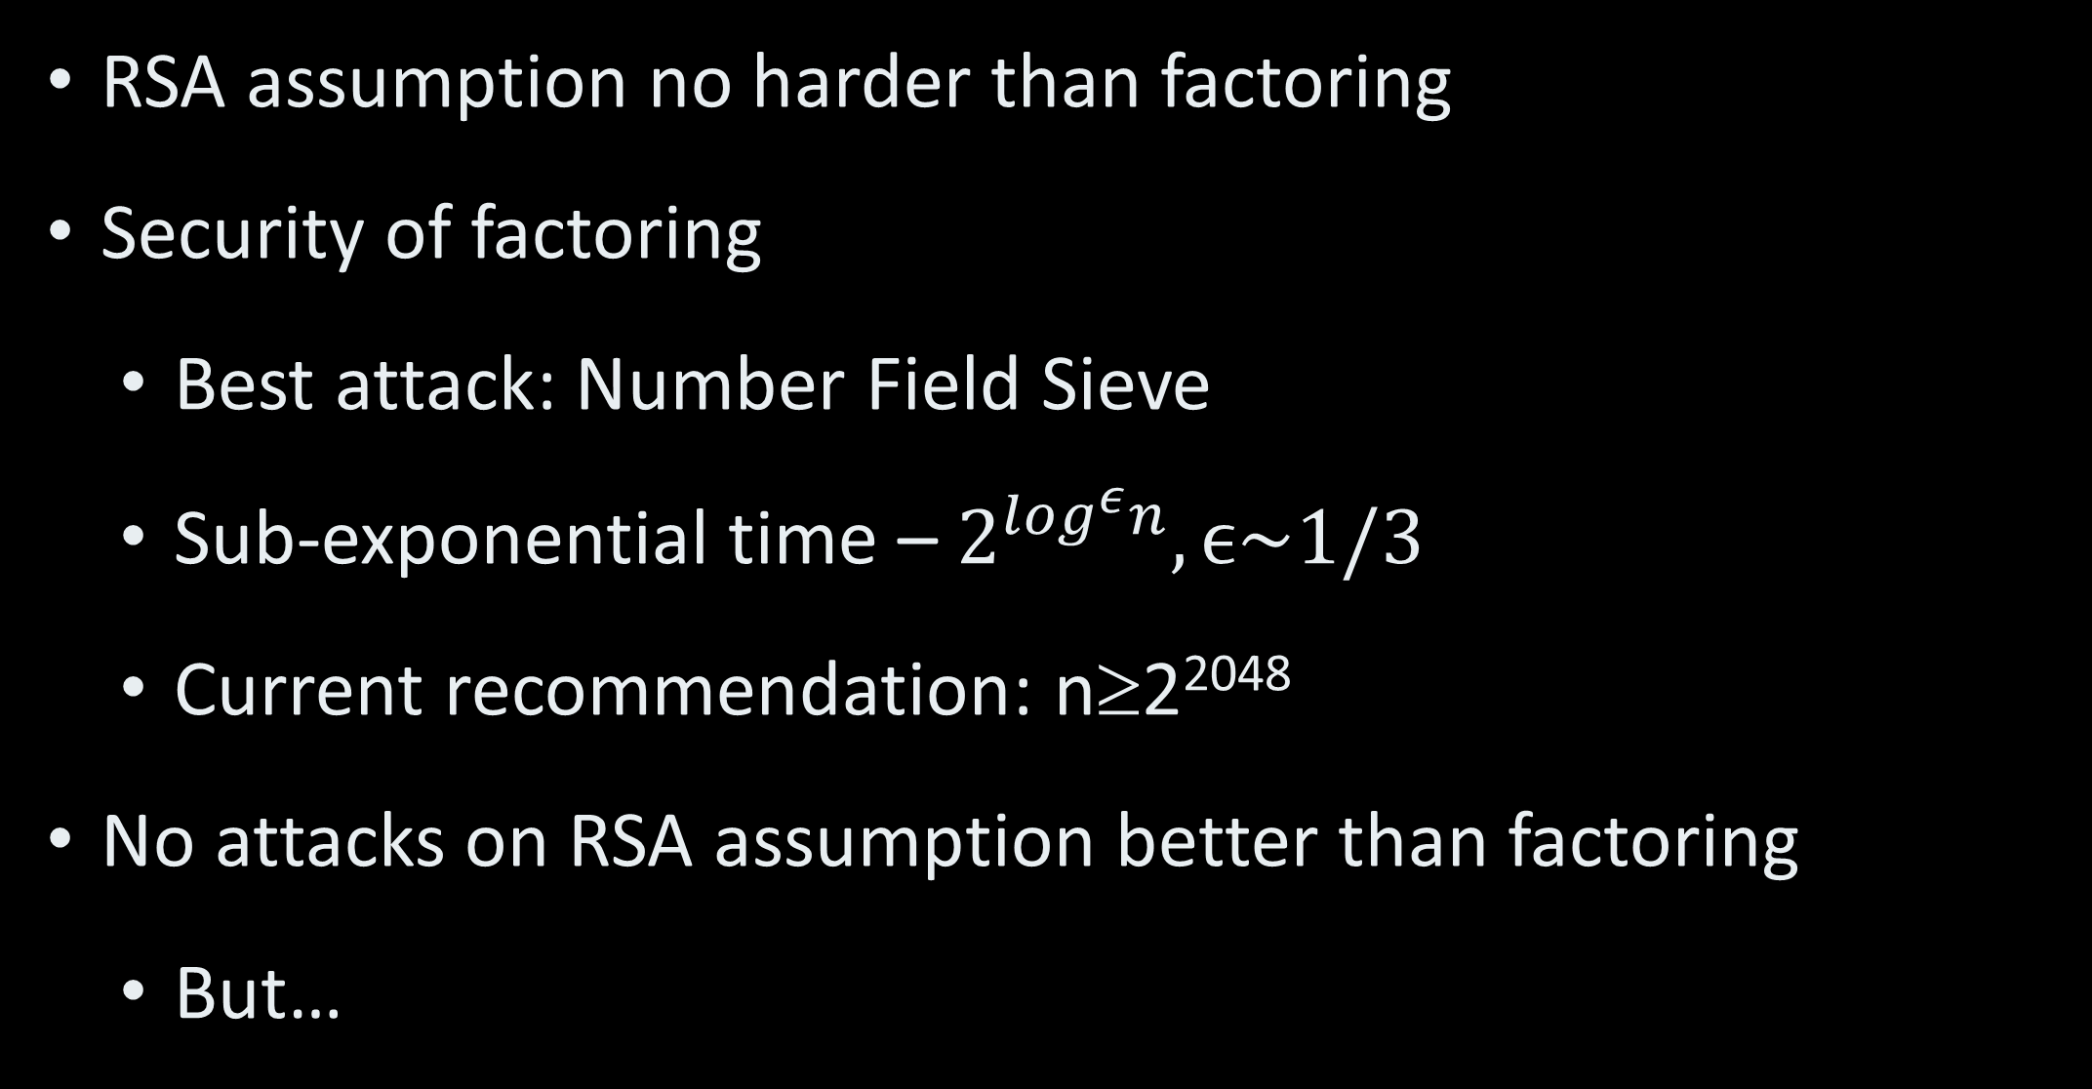
RSA Security II
RSA assumption no harder than factoring
Security of factoring
Best attack: Number Field Sieve
Sub-exponential time – $2^{\log^{ε}n}, ϵ\sim 1/3$
Current recommendation: n≥2²⁰⁴⁸
No attacks on RSA assumption better than factoring
But…

Slide 26
Attacks on RSA Variants I
RSA is “sensitive”
Leakage of p, q, ϕ(n), d breaks RSA
[Hastad] If e=3 then
Given m^{e} mod n_{i} for distinct n_{i}, i=1, 2, 3
Attacker can recover m
[Boneh-Durfee] If d<n0.29
Heuristic efficiently finds d

Slide 27
Attacks on RSA Variants II
Alice has key (n,e₁), Bob has key (m,e₂)
n=pq, m=qr
Attack – run gcd(n,m)=q and factor both m and n
Central key generation provides keys
Alice public key (n,e₁)
Bob public key (n,e₂), gcd(e₁,e₂)=1
Carol encrypts m for both Alice and Bob

Slide 28
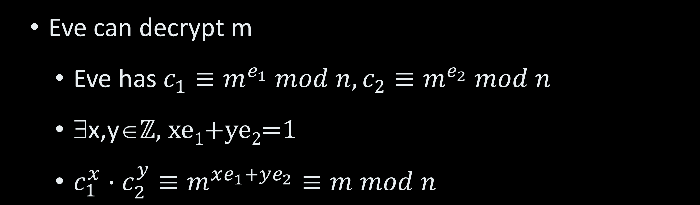
Attacks on RSA Variants III
Eve can decrypt m
Eve has $c_{1}≡m^{e_{1}} mod n, c_{2}≡m^{e_{2}} mod n$
∃x,y∈ℤ, xe₁+ye₂=1
$c_{1}^{x}∙c_{2}^{y}≡m^{xe_{1}+ye_{2}}≡m mod n$

Slide 29
RSA & Semantic Security
RSA is not semantically secure
It is deterministic!
Simple solution
Plaintext domain: {0,1}^{k}, k<(log n)-j
Encryption of m: (m||r)^{e} mod n
r random in {0,1}^{j}

Slide 30
RSA Performance
RSA decryption
One exponentiation modulo n
50-100 decryptions a second on standard computer
RSA encryption
Exponentiation in “short e”
➔~log e multiplications (of large numbers)
100 times faster than decryption

Slide 31
RSA Standards
Standardized by
RSA corporation (now EMC)
IETF
Others
Public Key Cryptographic Standards (PKCS)
PKCS#1 – standard for RSA encryption
Version 1.5 – semantic security
Version 2.1 – Chosen ciphertext security

Slide 32
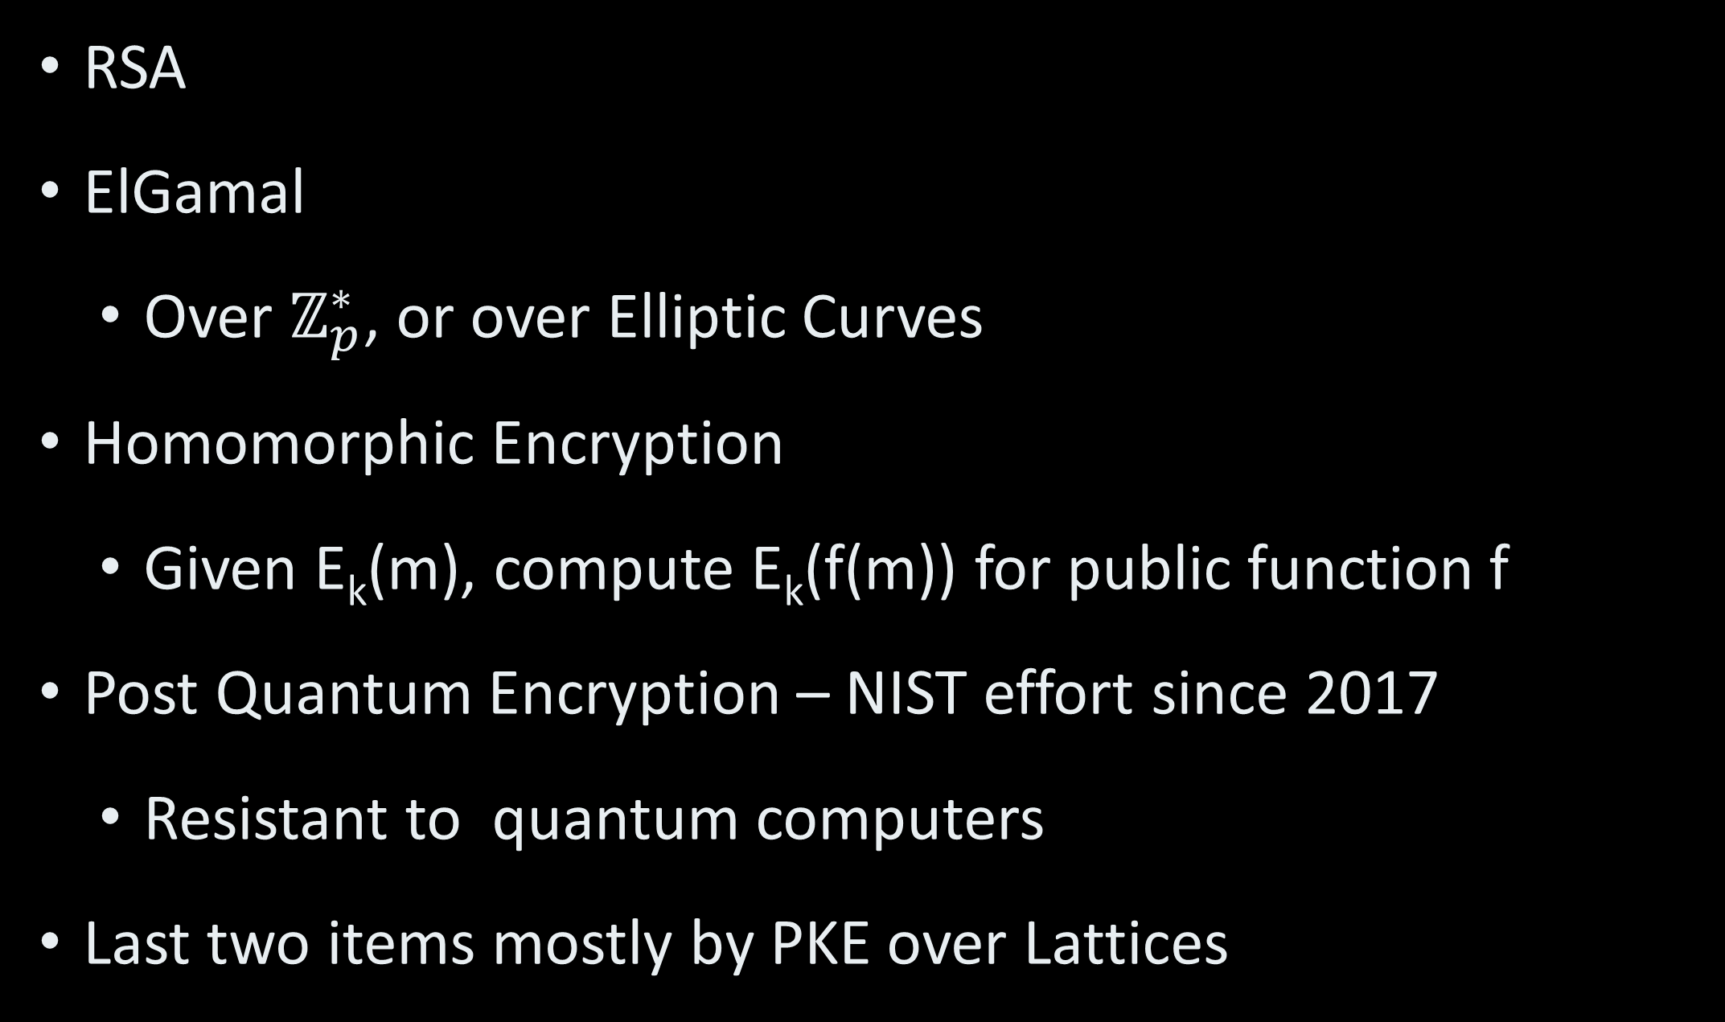
Useful PKE Systems
RSA
ElGamal
Over $ℤ_{p}^{∗}$, or over Elliptic Curves
Homomorphic Encryption
Given E_{k}(m), compute E_{k}(f(m)) for public function f
Post Quantum Encryption – NIST effort since 2017
Resistant to quantum computers
Last two items mostly by PKE over Lattices

Slide 33
PKE Application: Key Ex.
Alice
Bob
Generate private x, public y
Sample shared key k
Public y
c=E_{y}(k)
k=D_{x}(c)

Slide 34
PKE Application: Ransomware
Attacker Executes malware on target system
Malware
Encrypts target files
Posts ransom note
Pay sum in Bitcoin or lose files
Upon payment attacker provides encryption key

Slide 35
Ransomware
Alice
Eve
Public y, malware V
Infection!
Generate private x, public y
Malware V
Sample k
Encrypt doc d →AES_{k}(d)
Erase k
Encrypt key c=RSA_{y}(k)
Post ransom note
Money, c
k

